Slide 1
Is Augmented Reality the Future?
TJ VanToll (@tjvantoll)

Slide 2


Slide 3
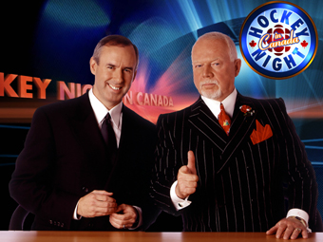

Slide 4
Augmented Reality

Slide 5

TJ VanToll ⚡️
Principal Developer Advocate
@tjvantoll

Slide 6


Slide 7
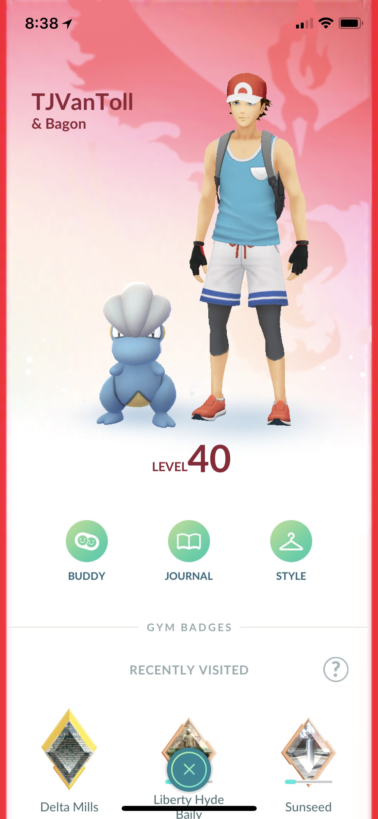

Slide 8
Agenda
Brief history of AR
AR today
Building AR apps

Slide 9
Augmented Reality (AR) is the integration of digital information with the user’s environment in real time.

Slide 10
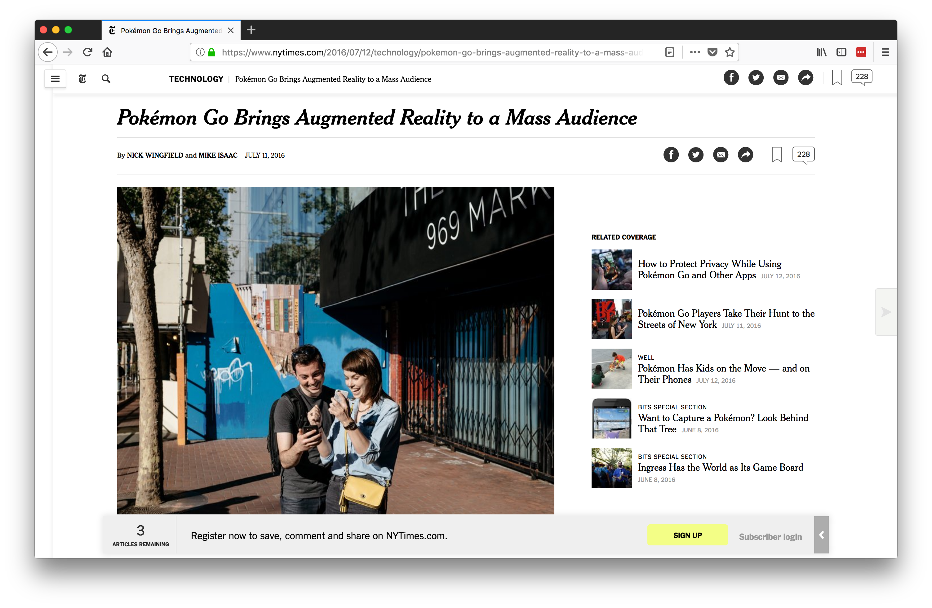
Notes:
1974 Cleveland Indians

Slide 11
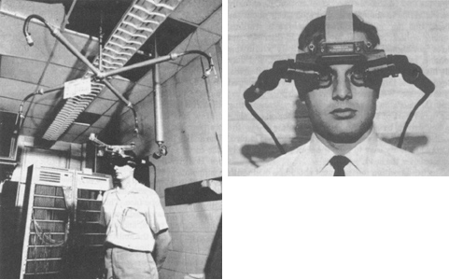
Source: https://www.wareable.com/ar/everything-you-need-to-know-about-augmented-reality
Notes:
Ivan Sutherland, 1968
Had to be suspended from the ceiling

Slide 12

Notes:
Fox acquired rights to the NHL in 1994
Used for two NHL seasons (96–97, 97–98)

Slide 13
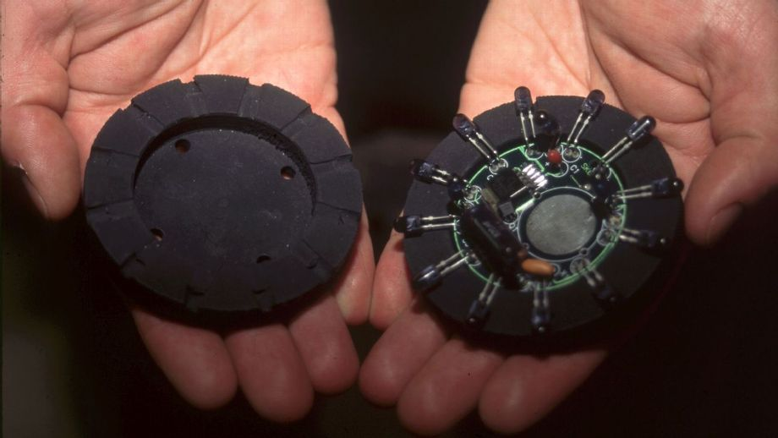
Image from http://www.espn.com/nhl/story/_/id/21080555/nhl-bring-back-infamous-glow-puck
Notes:
used infrared technology to follow LED lights that were imbedded inside the puck. They pulsed 30 times per second as modified cameras picked up the signal
the pucks were not re-usable, and only had a battery life of around 18 minutes

Slide 14
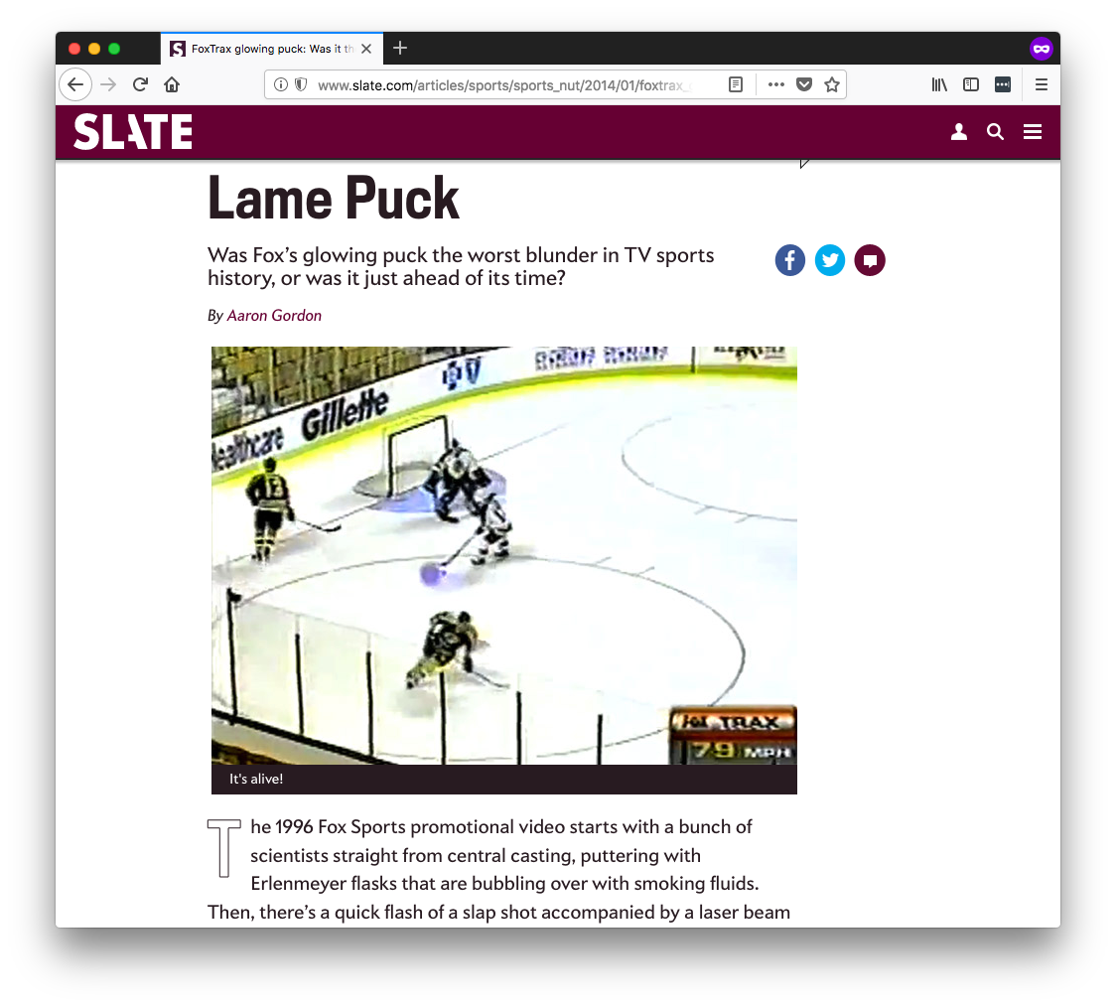
Source: http://www.slate.com/articles/sports/sports_nut/2014/01/foxtrax_glowing_puck_was_it_the_worst_blunder_in_tv_sports_history_or_was.html
Notes:
1974 Cleveland Indians

Slide 15
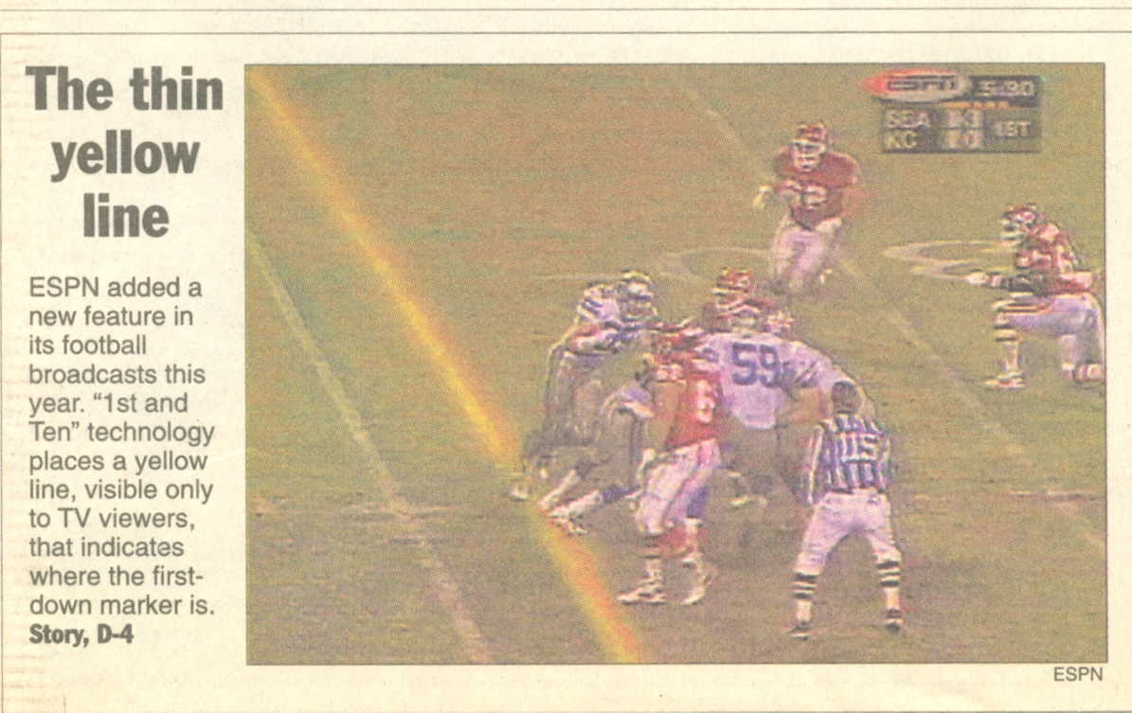
Notes:
1998

Slide 16
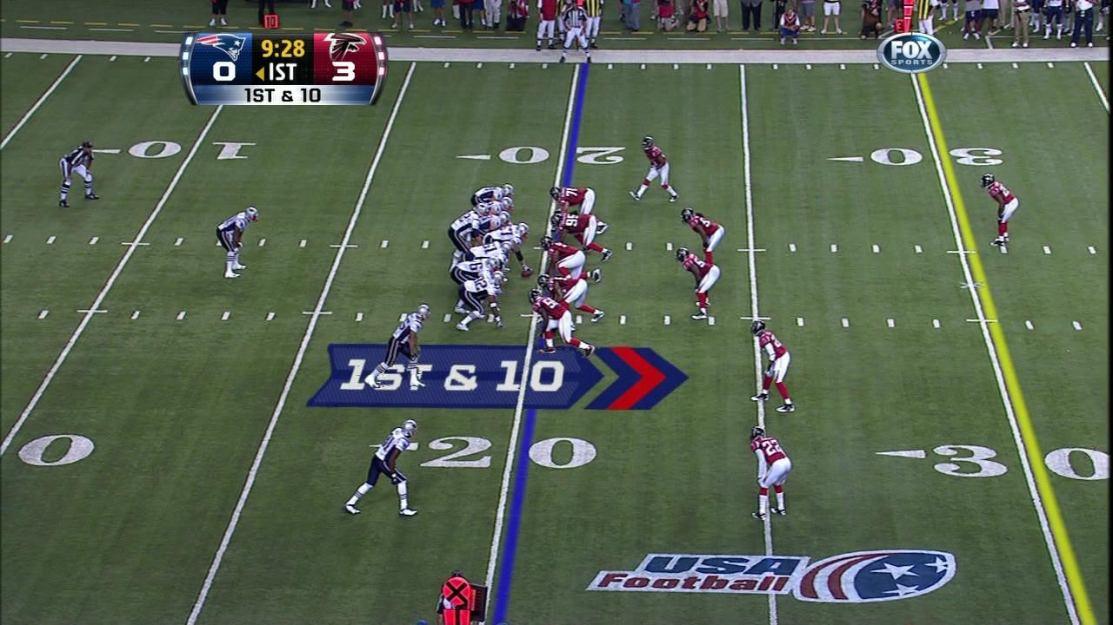
Image from https://gobraithwaite.com/creative-marketing-saved-nfls-yellow-first-line/

Slide 17
“It probably cost the broadcaster $25,000-$30,000 for a weekend back then.
We had to roll out an entire truck to make it work for games in the early days. It was five racks of equipment, a lot of engineers, a traveling circus.”
Source: http://mashable.com/2013/09/25/yellow-first-down-line/

Slide 18
“Now it's basically one computer”

Slide 19
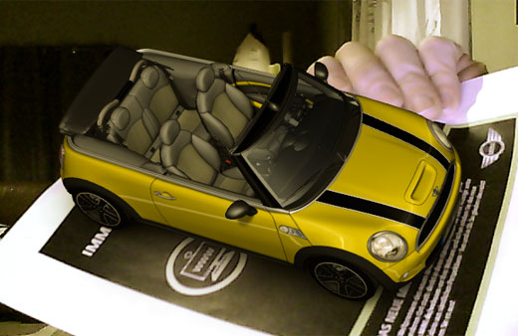
Source: https://technabob.com/blog/2008/12/17/mini-augmented-reality-ads-hit-newstands/
Notes:
2008 BMW first commercial application
Used computer webcam
IE Only ActiveX

Slide 20
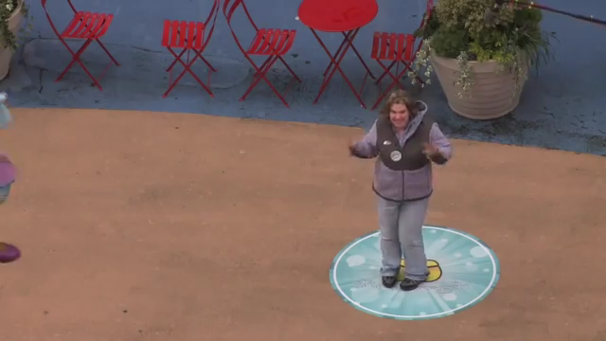
Notes:
2011
Disney
Times Square

Slide 21
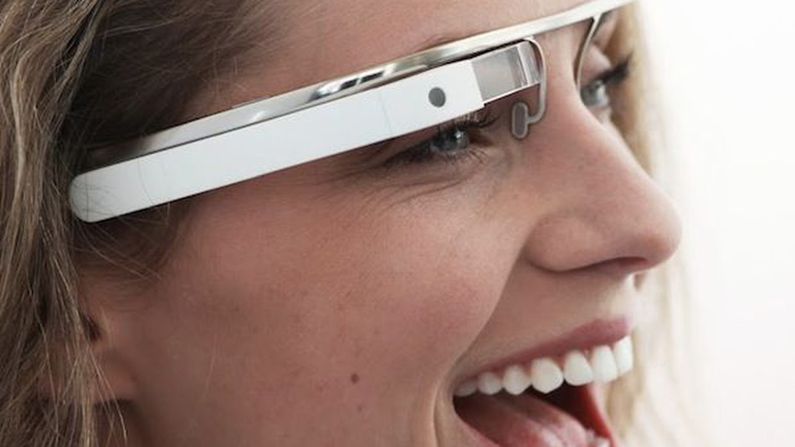
Source: http://mashable.com/2012/04/04/google-glasses-project-glass/
Notes:
2012
$1,500

Slide 22
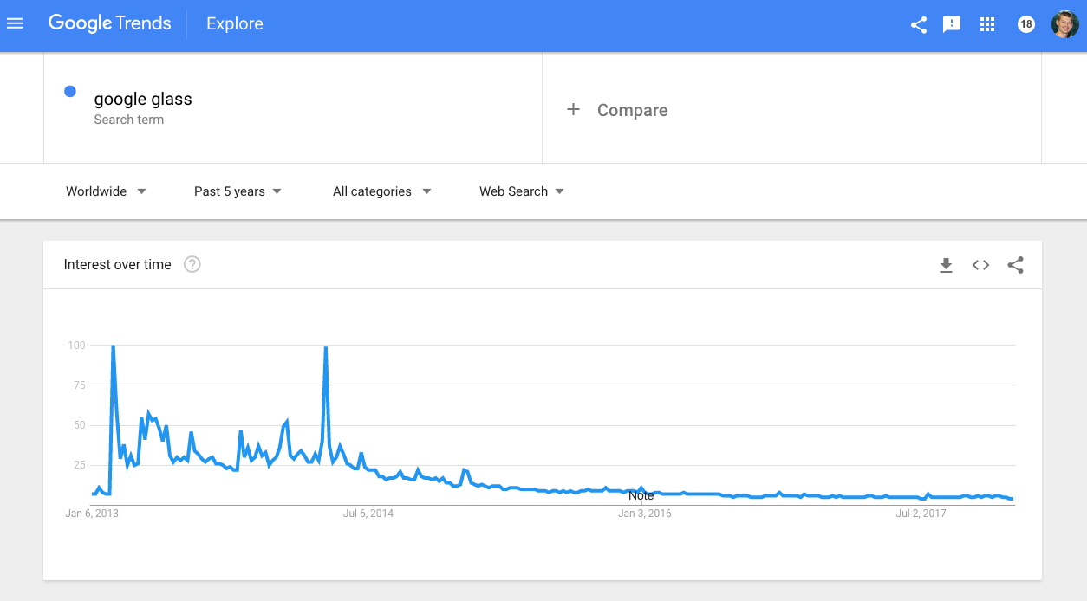

Slide 23
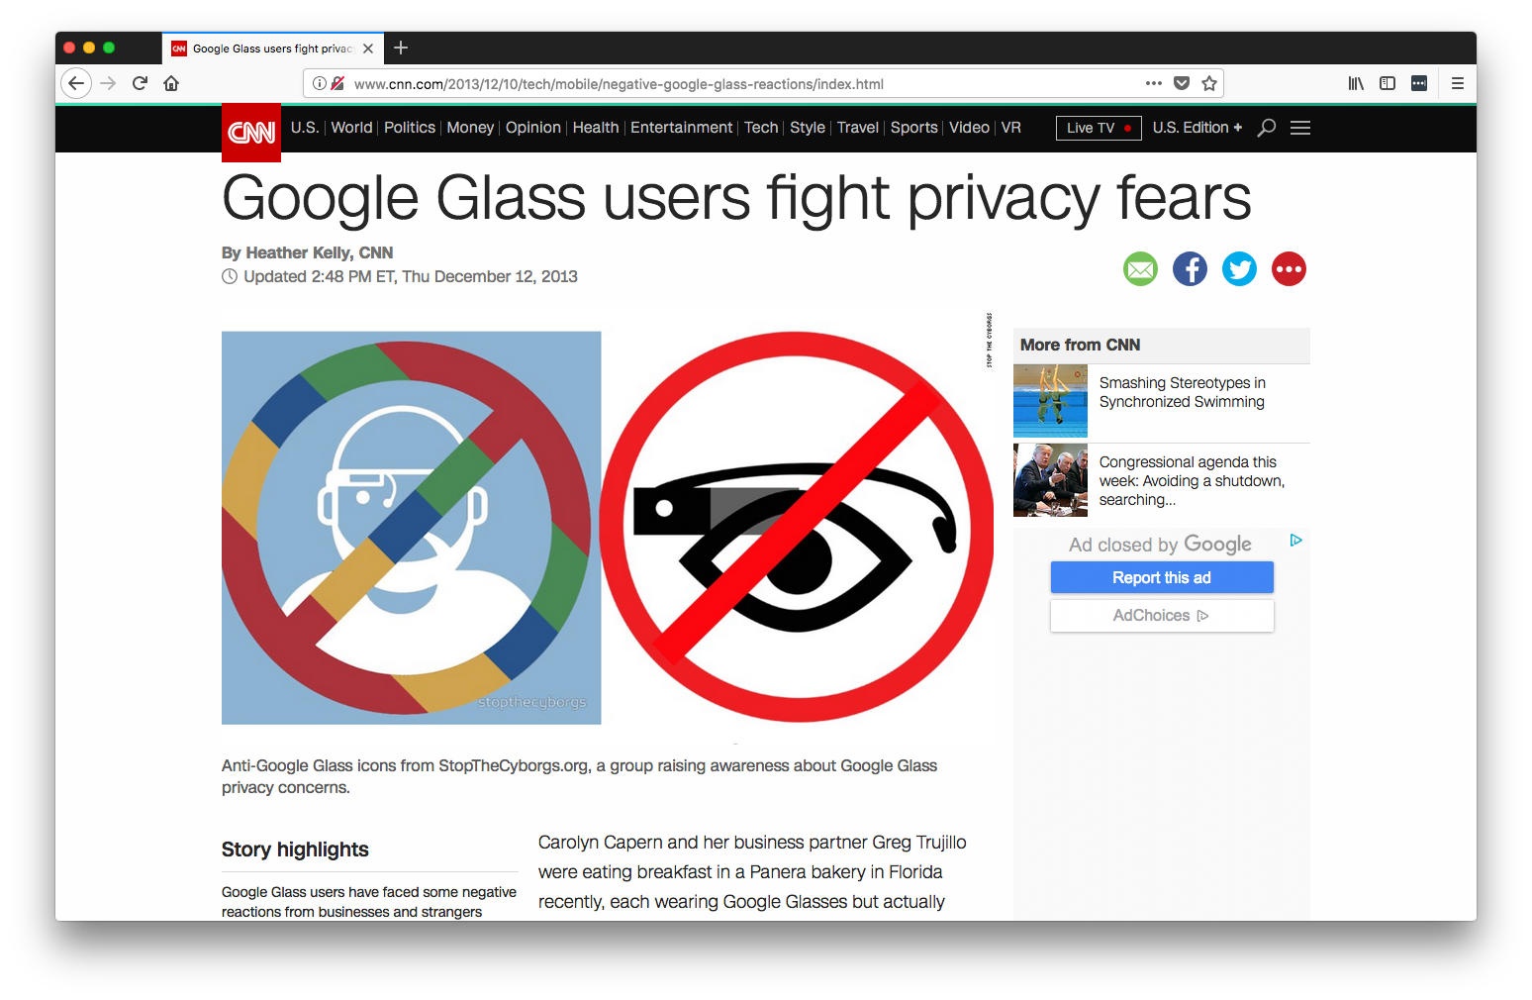

Slide 24
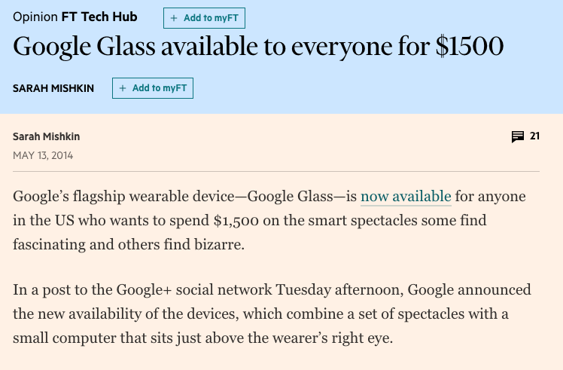

Slide 25


Slide 26
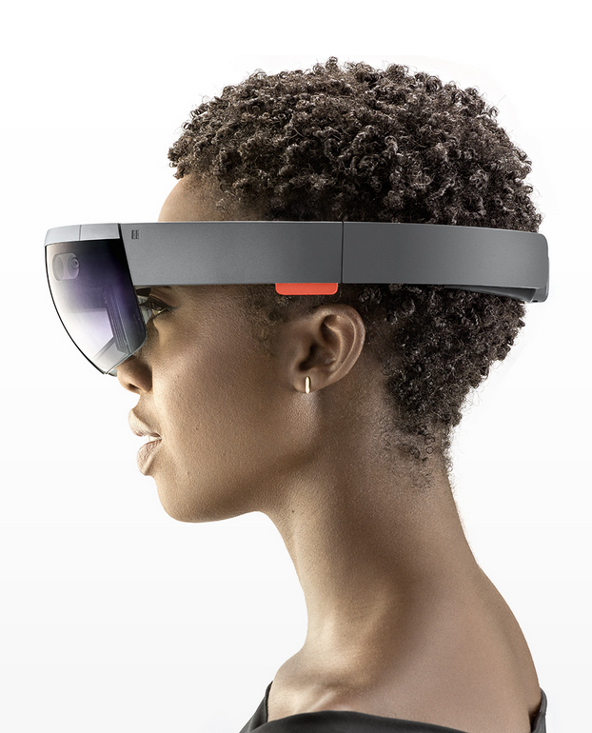
Notes:
2015

Slide 27
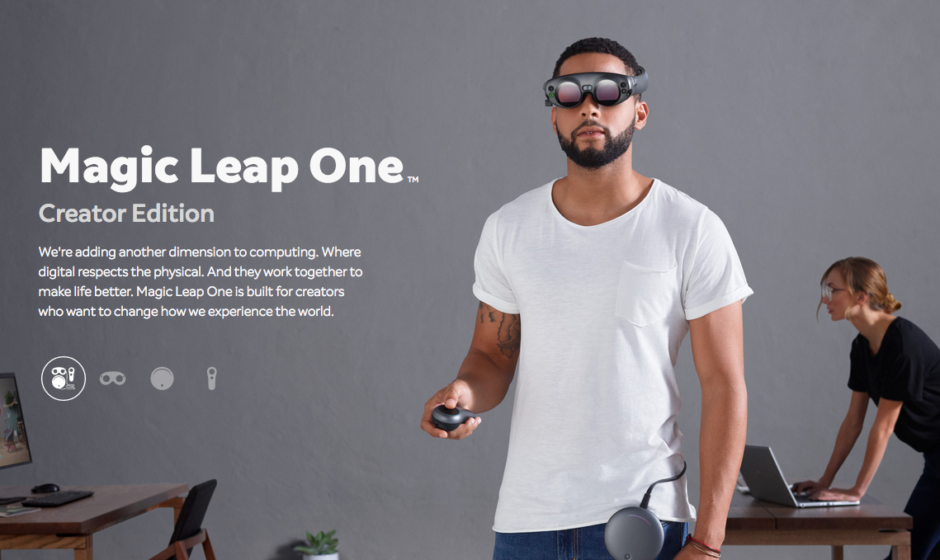
Notes:
Lightwear, Lightpack
Raised ~$2 billion to date

Slide 28
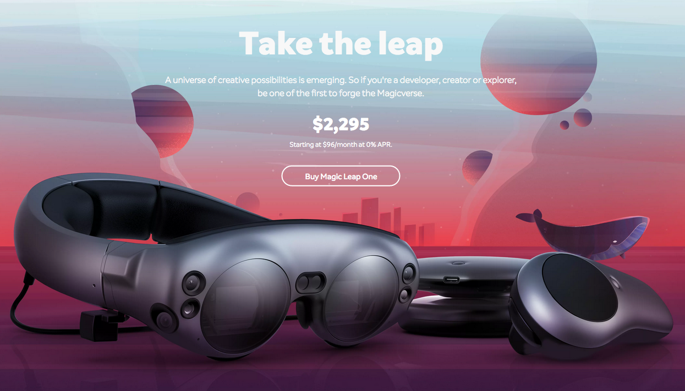

Slide 29
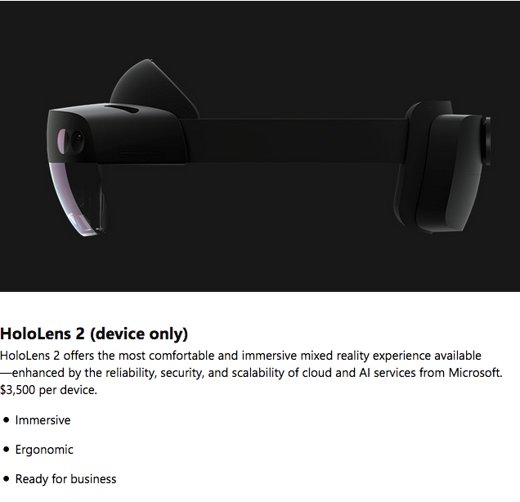

Slide 30
Agenda
Brief history of AR
AR today
Building AR apps w/JS

Slide 31
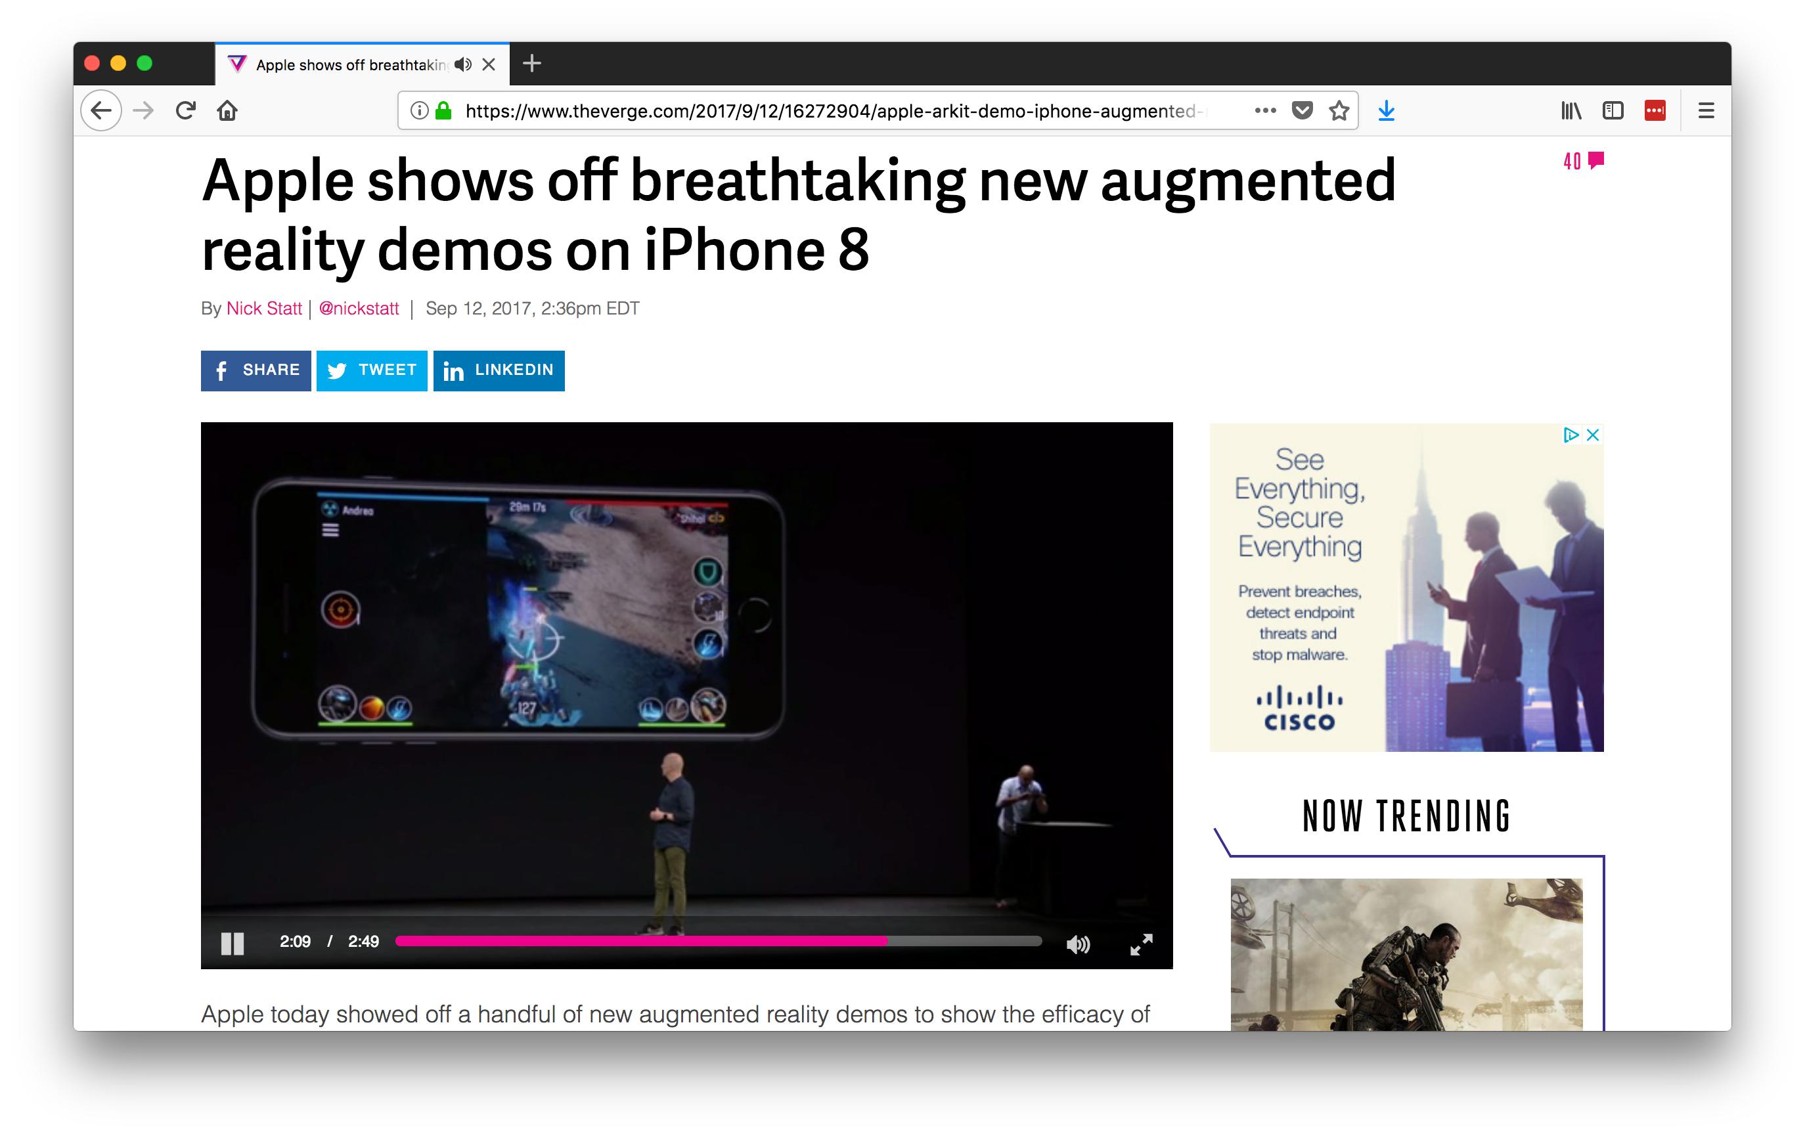
Notes:
ARKit shipped with iOS 11

Slide 32
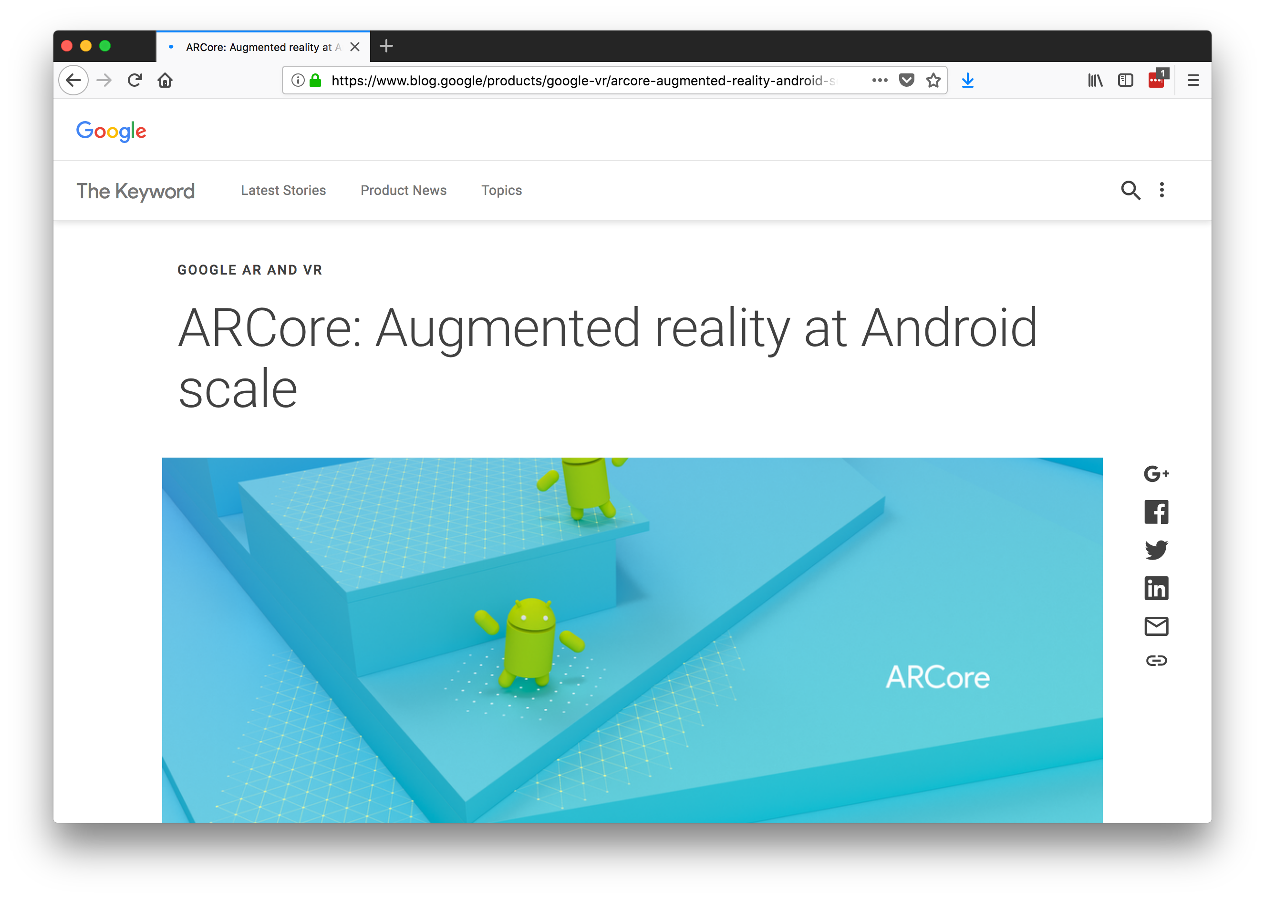
Notes:
August 2017
Today is still in a “developer preview”

Slide 33
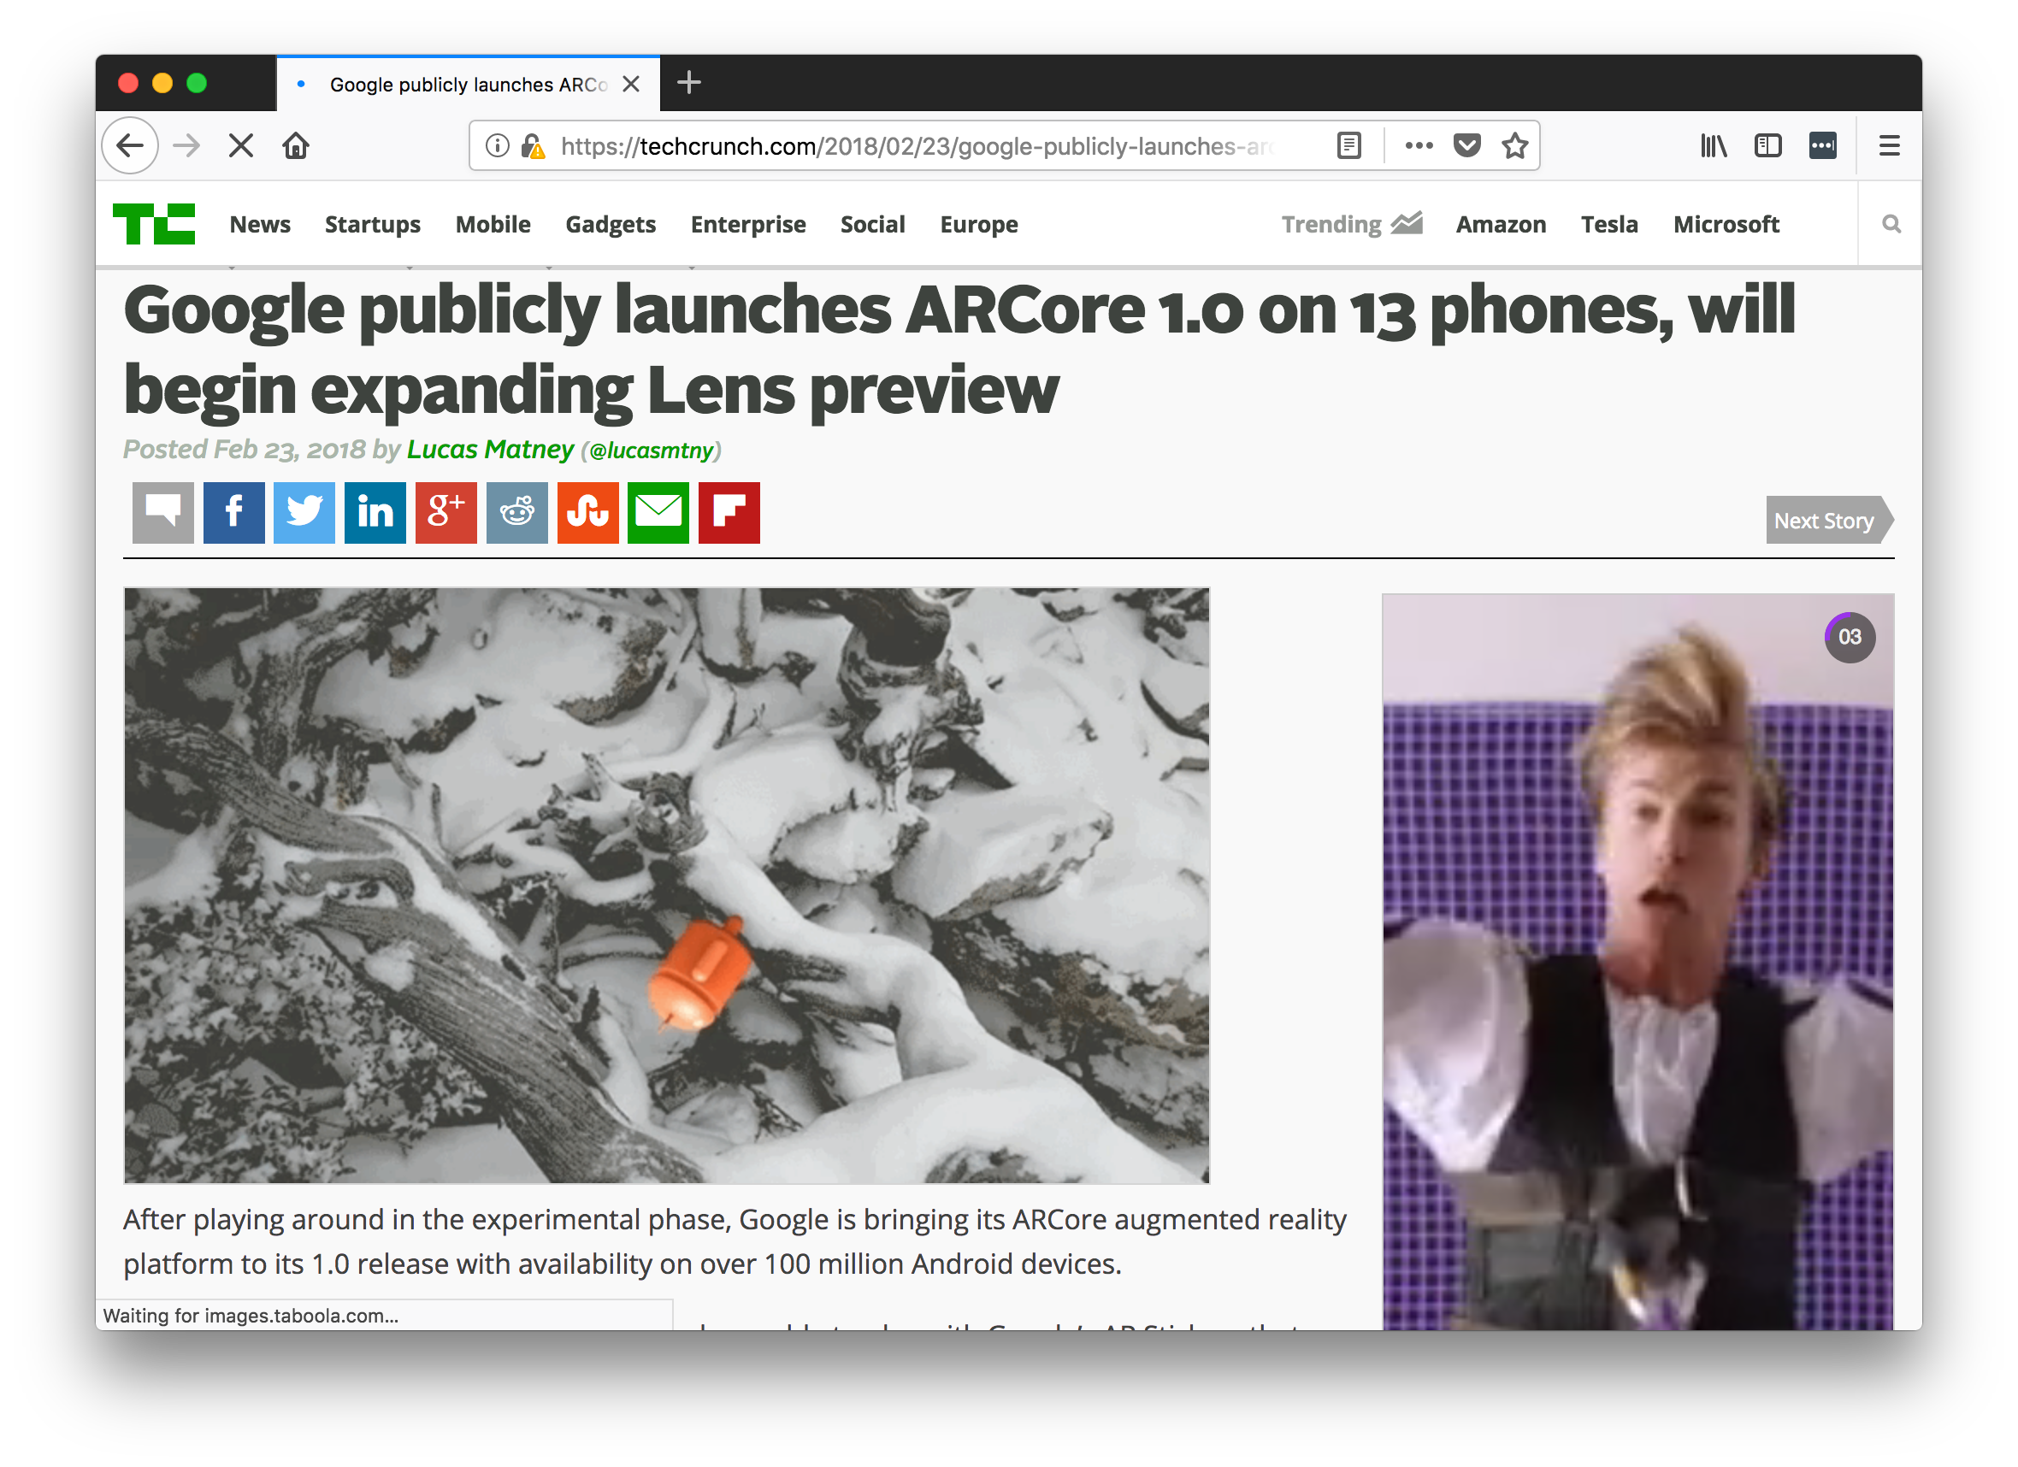

Slide 34
Device Support
ARKit
iPhone 6S+
iPad Pros and Generation 5+ regular iPads
ARCore
Pixel+
Galaxy S8, S8+, Note8, S7 and S7 edge
Notes:
iOS limitation—A9 chip

Slide 35
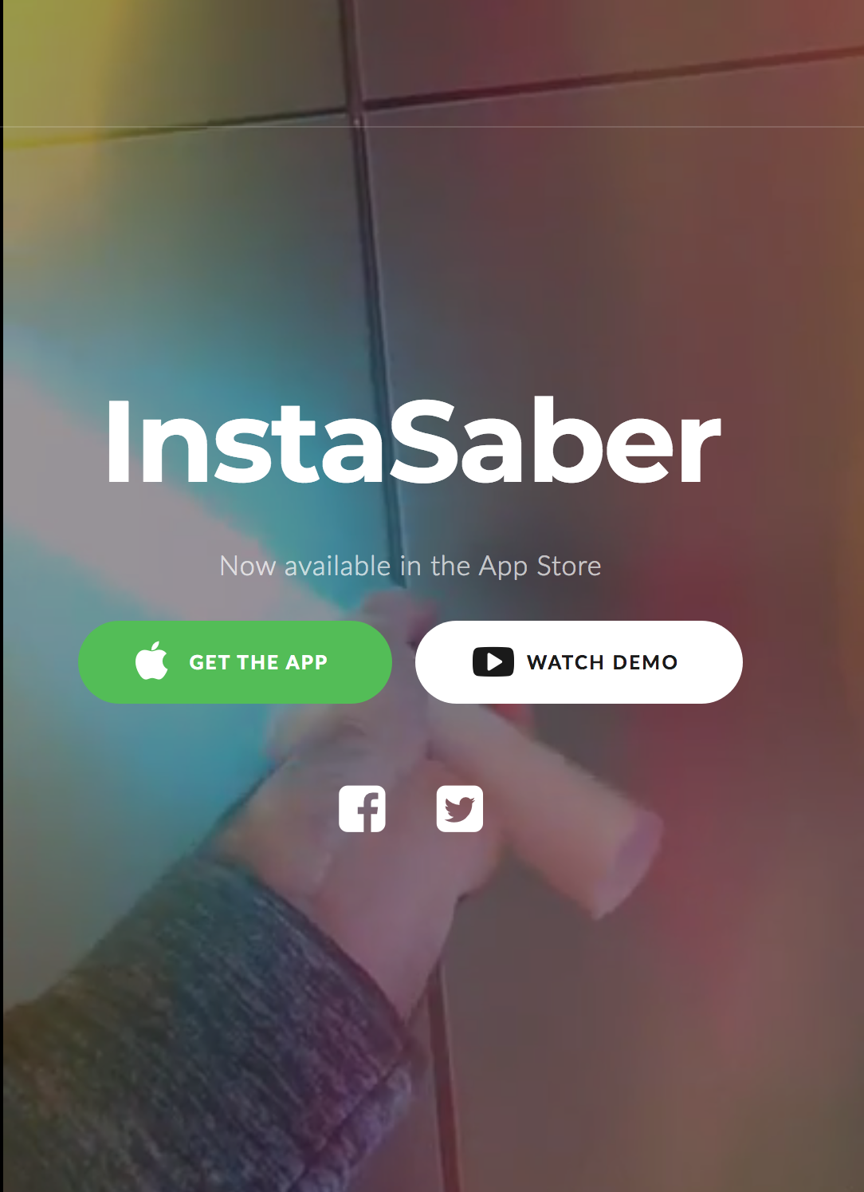
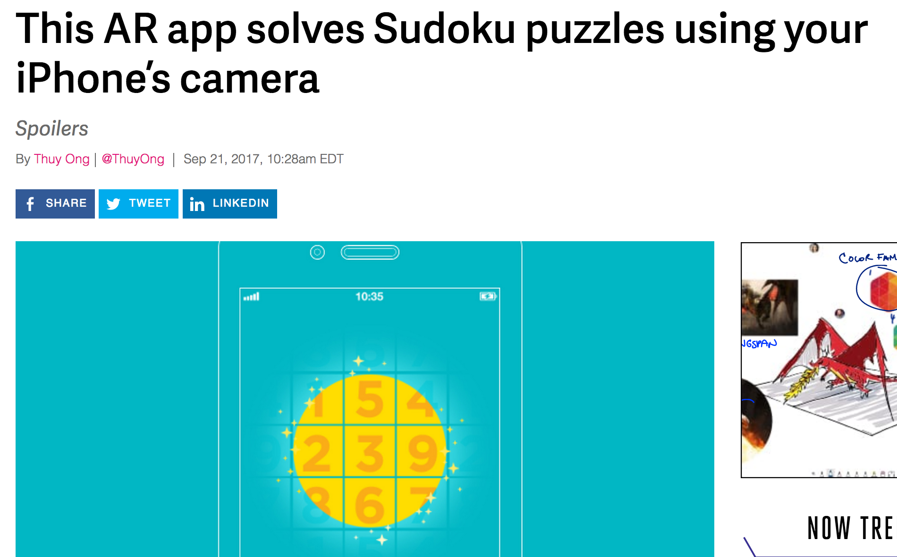
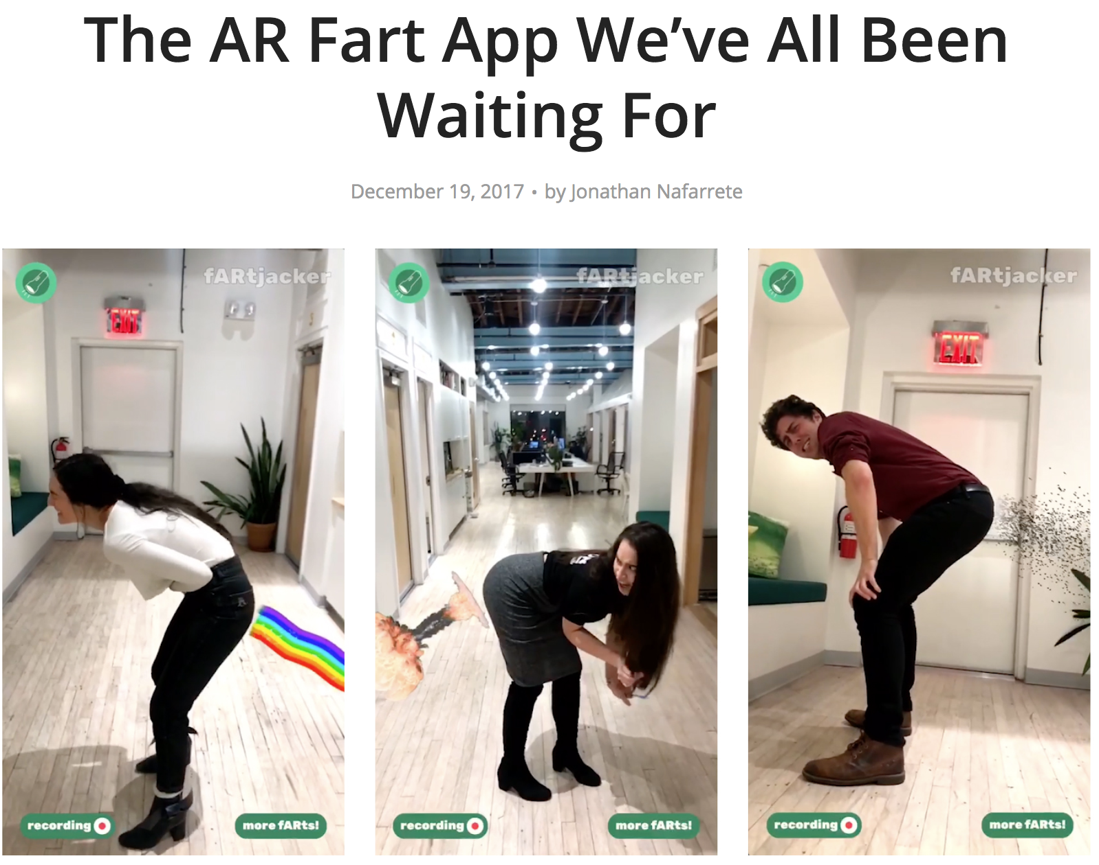

Slide 36
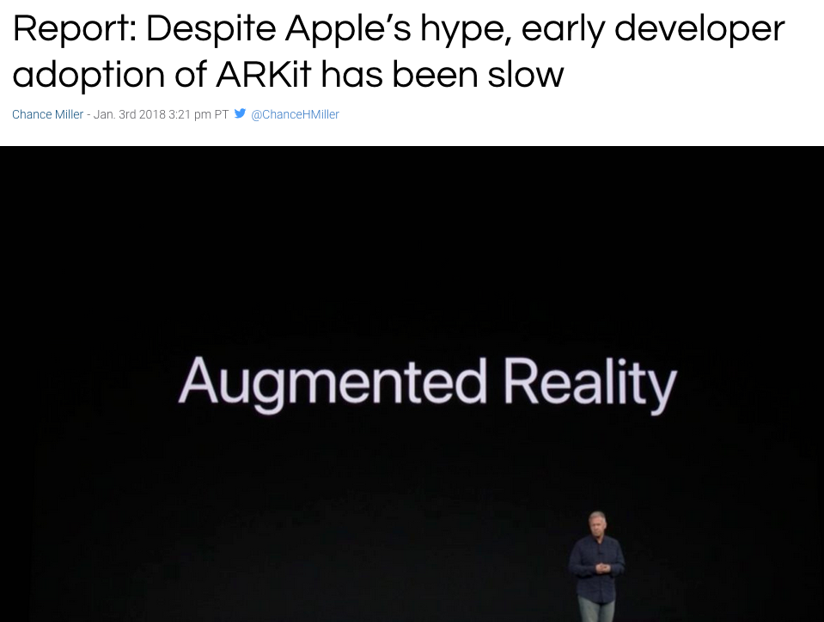

Slide 37
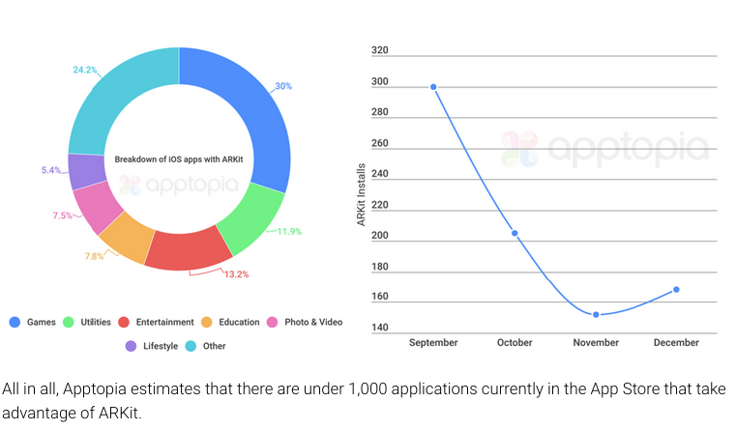

Slide 38
Agenda
Brief history of AR
AR today
Building AR apps w/JS

Slide 39


Slide 40


Slide 41


Slide 42
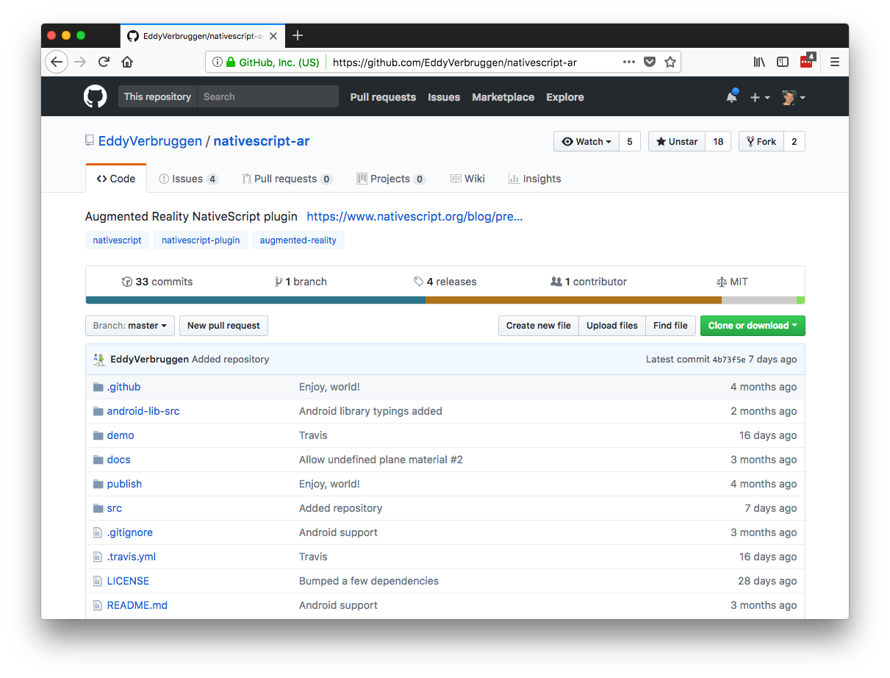

Slide 43
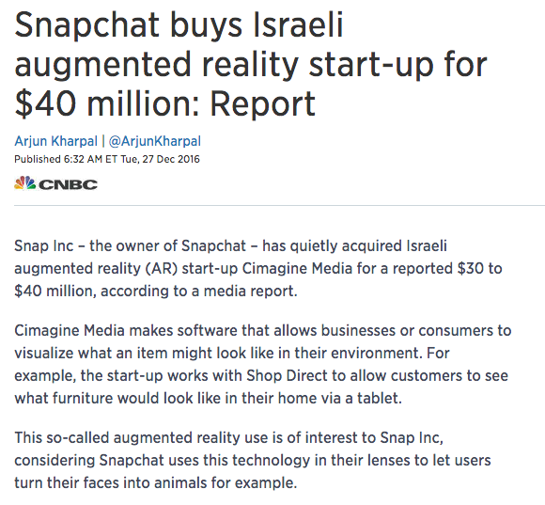
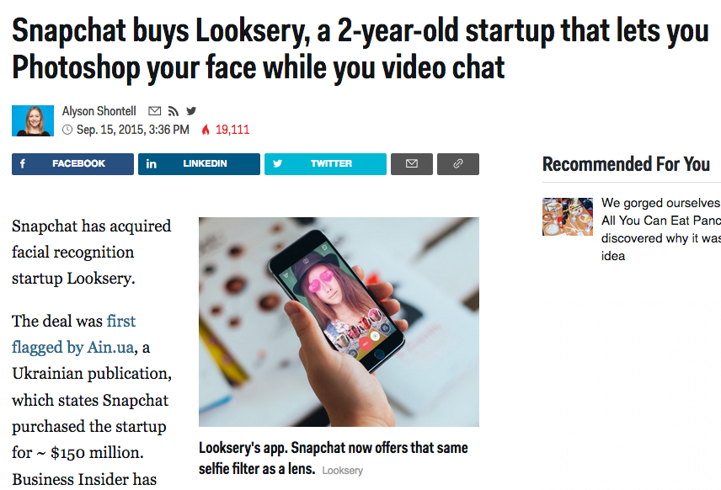

Slide 44
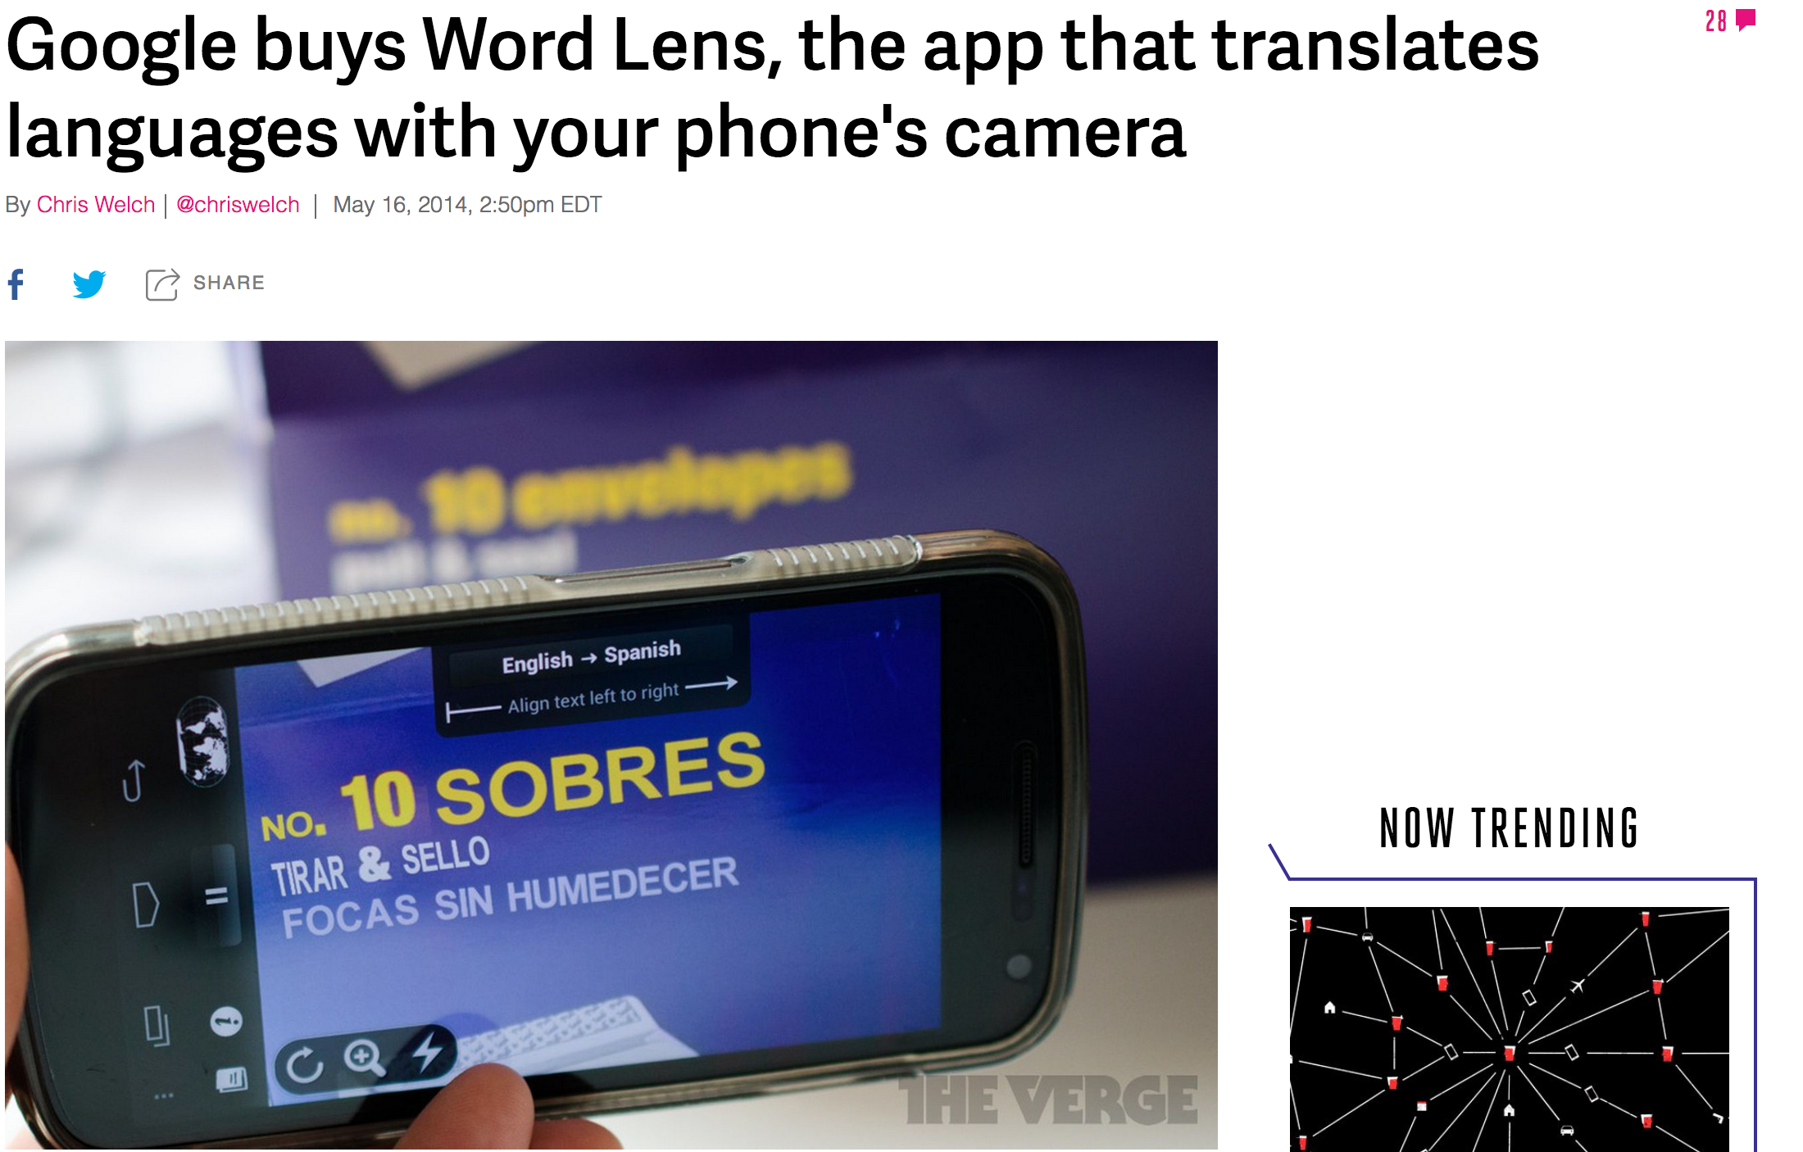

Slide 45
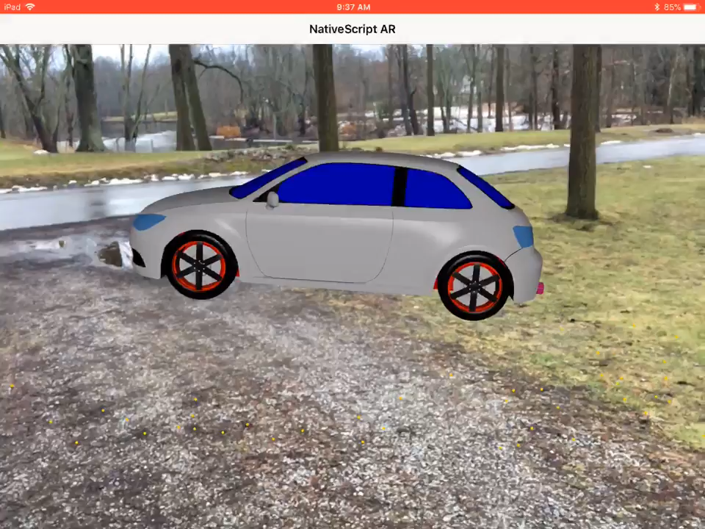

Slide 46
Summary
AR is cool.
AR is hard.
It’s probably a few years before AR is simple enough for your average developer to build something compelling with.

Slide 47
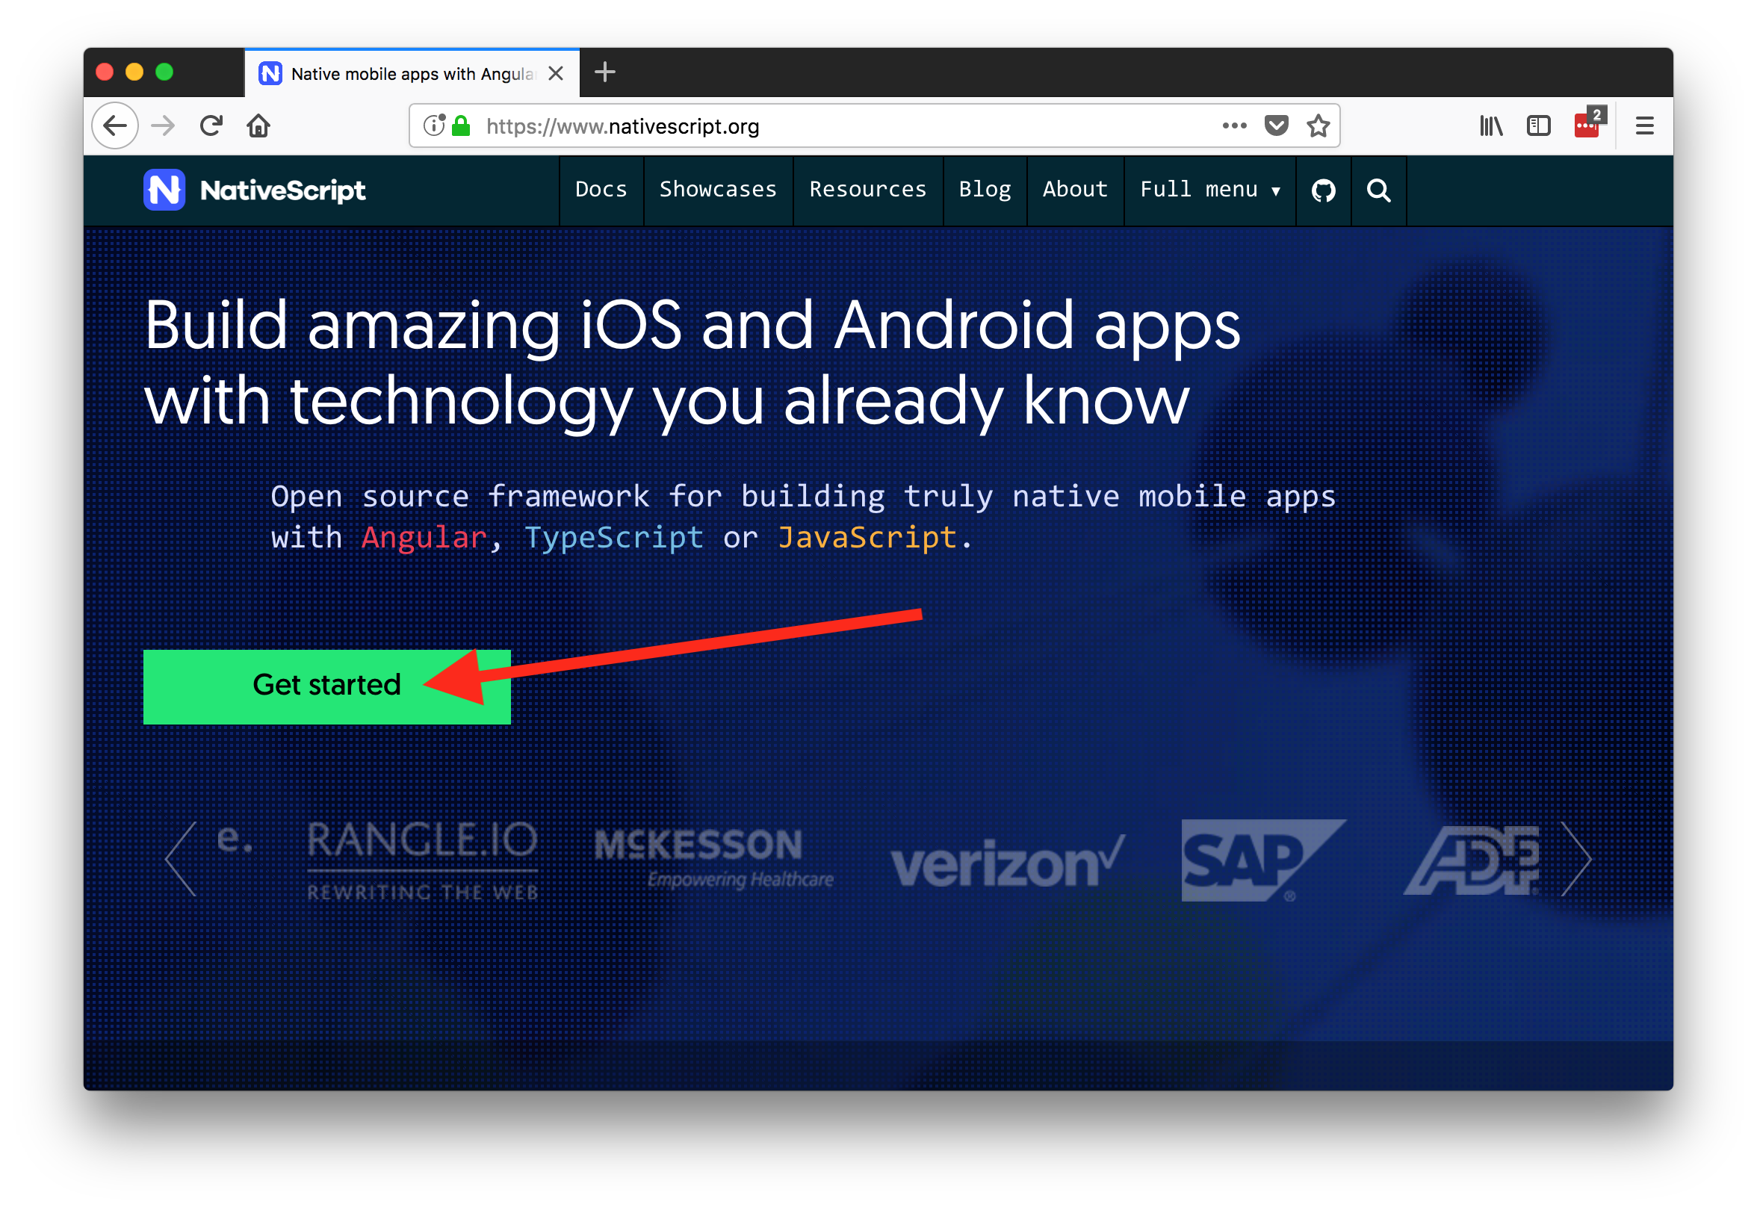

Slide 48

Thanks! 😊
@tjvantoll

